Slide 1


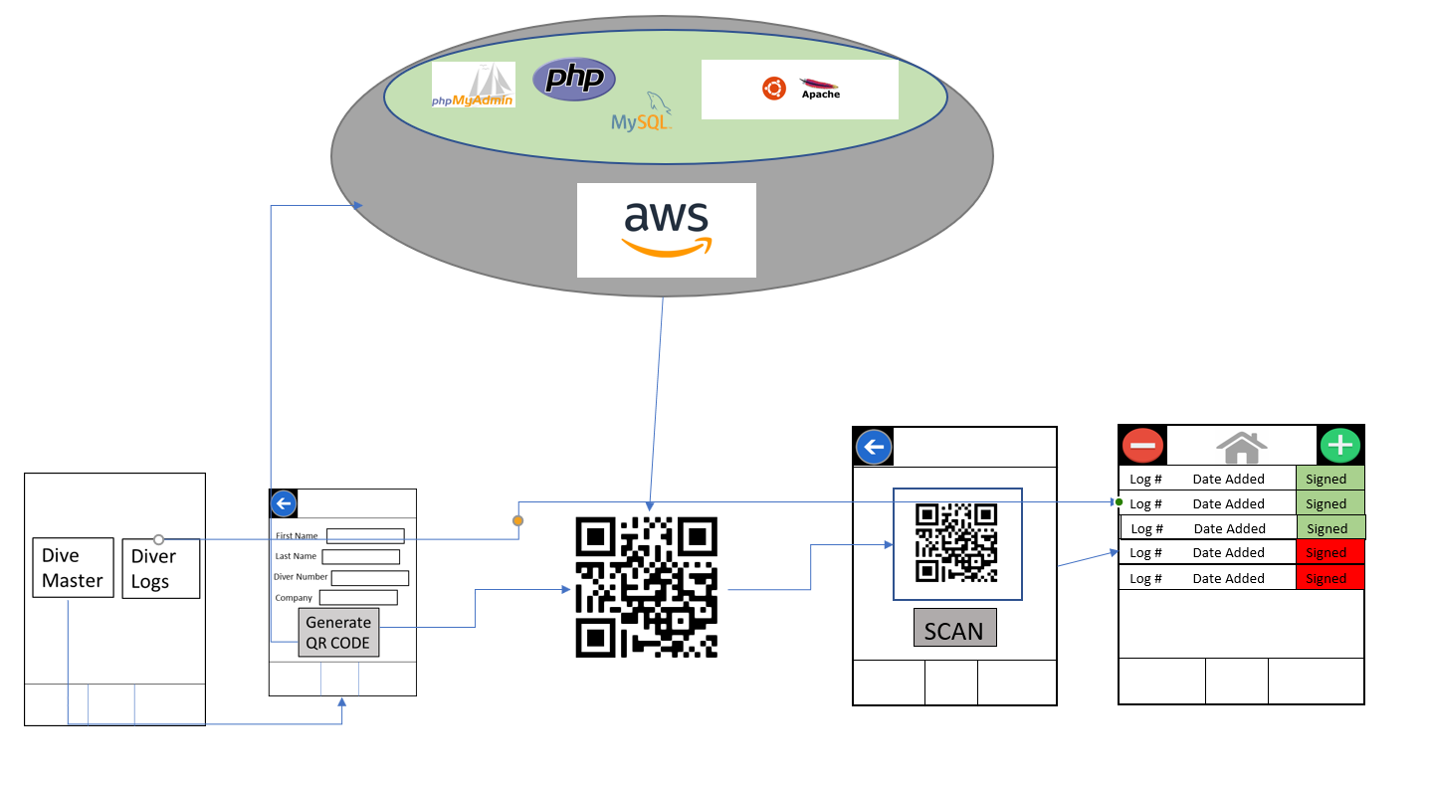

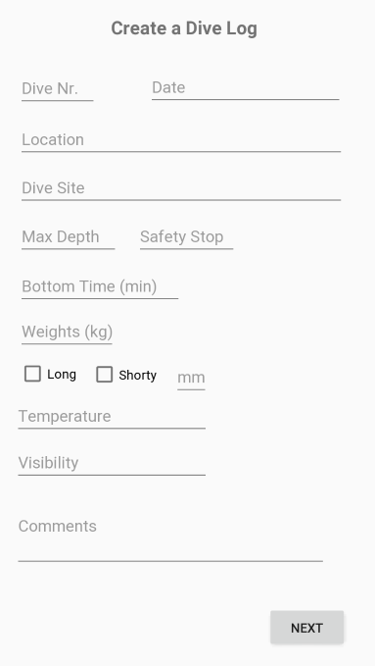
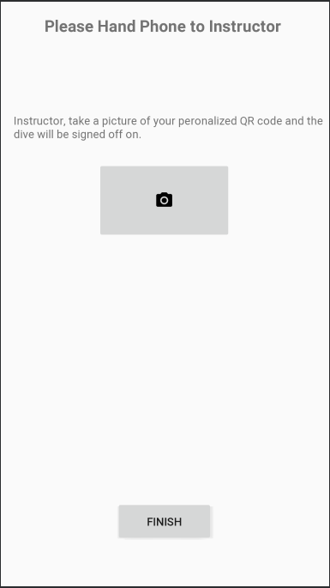
DDLS
Technologies
Android Studio - the main application used to create the DDLS App
Amazon Web Service - this is the main service in which the MySQL server is stored on as well as PHP scripts, phpmyadmin, and Apache2 web services.
MySQL - the database host that is used to store the Dive Master information and that can be retrieved by the app
PHP - used to transfer information sent from DDLS to the the MySQL DB and back. These scripts are located on the AWS server.
Phpmyadmin - interface that makes monitoring MySQL databases more efficient
Ubuntu 18.04 LTS - The operating system that the AWS server is running
Digital Dive Log Signature System
High Level Design
Aaron Suchovksy
CS
Vince Augustine
CS
Advisor: Dr. Wen Ben Jones
Problem
Dive Logs have become outdated and having a Dive Master physically signing a substantial amount of divers Dive Logs can put a lot of strain on the Dive Master’s hand or take a large amount of time.
Solution
Our system will make the signing of the logs easier by the divers scanning the dive masters QR code that holds a digital signature and have it applied to the digital dive log.
App Screenshots
Challenges
Creating the Database to store Dive Master information: This was originally on a Raspberry Pi 4 but due to some issues with connecting to it, an AWS server was created in its place making connecting to it easier and easier to manage.
Overcoming the Challenges of Android Studio: We had beginning level knowledge of Android Studio and had to overcome the many challenges that the language and studio brought that was different from normal programming.
COVID-19: Interrupting communication and making meeting more difficult.
Intellectual Merits
This app will impact the diving world in the most positive way.
It will make the lives of divers and dive masters much easier through the creation of the app.
Divers will no longer have to travel and hand logs in physically, which create more of an automated and easy system.
With this app, many more people will want to start diving because of the ease of an automated system.

